Slide 1
Lightning Workshop
3/10/2015
Notes:
Welcome everyone

Slide 2

Jeff Douglas
Developer Evangelist Architect
Appirio & Topcoder
@jeffdonthemic
Notes:
Introduce yourselves

Slide 3
Safe Harbor
Safe harbor statement under the Private Securities Litigation Reform Act of 1995: This presentation may contain forward-looking statements that involve risks, uncertainties, and assumptions. If any such uncertainties materialize or if any of the assumptions proves incorrect, the results of salesforce.com, inc. could differ materially from the results expressed or implied by the forward-looking statements we make. All statements other than statements of historical fact could be deemed forward-looking, including any projections of subscriber growth, earnings, revenues, or other financial items and any statements regarding strategies or plans of management for future operations, statements of belief, any statements concerning new, planned, or upgraded services or technology developments and customer contracts or use of our services.
The risks and uncertainties referred to above include – but are not limited to – risks associated with developing and delivering new functionality for our service, our new business model, our past operating losses, possible fluctuations in our operating results and rate of growth, interruptions or delays in our Web hosting, breach of our security measures, risks associated with possible mergers and acquisitions, the immature market in which we operate, our relatively limited operating history, our ability to expand, retain, and motivate our employees and manage our growth, new releases of our service and successful customer deployment, our limited history reselling non-salesforce.com products, and utilization and selling to larger enterprise customers. Further information on potential factors that could affect the financial results of salesforce.com, inc. is included in our annual report on Form 10-K for the most recent fiscal quarter ended July 31, 2011. This document and others are available on the SEC Filings section of the Investor Information section of our Web site.
Any unreleased services or features referenced in this or other press releases or public statements are not currently available and may not be delivered on time or at all. Customers who purchase our services should make the purchase decisions based upon features that are currently available. Salesforce.com, inc. assumes no obligation and does not intend to update these forward-looking statements.
Notes:
Use this to remind employees about this policy, and that roadmap is not guaranteed.

Slide 4
Agenda
15min- Welcome & Kick-off
30 mins – Salesforce1 Lightning Overview presentation & demo
60mins - Hands-on Tutorials: (pick two): Lightning App Builder, Lightning Components, Lightning Connect, & Lightning Process Builder
30 mins – Network, Q&A, Socialization.

Slide 5

LIGHTNING WEEK
March 9 – March 13
100+ Dev Groups Worldwide
Get Hands-On
Meet the Experts
http://developer.salesforce.com/lightning
#golightningfast
Notes:
Welcome to today’s Lighting Week meetup – this is part of a 100 city tour of Salesforce User Groups and Developer Groups.
Your one stop shop for all internal Lightning info is http://developer.salesforce.com/lightning
Please use #golightningfast on social media to share your experiences in this workshop with other admins and developers.

Slide 6
Lightning Overview
Notes:
Before we get into the details and tutorials for each technology, let’s talk a bit about the world we live in – one where mobile apps are everywhere. Employees and customers expect up-to-date apps and information. Businesses need the ability to iterate and respond to change just as quickly as consumer apps. Your job is to help those businesses be more agile.

Slide 7




Organizations Struggle To Build Custom Mobile Apps
Less than ½ have deployed apps
Mobile apps are critical
App Gap
Complexity of form factors
Limited number of developers
Multiple operating systems
Multiple platforms
Mobile apps deployed
Notes:
And why is this important?
Because many organizations are still struggling with deploying mobile apps. In fact, less than half of the organizations who consider mobile critical, have deployed apps.
We call this the app gap. It is caused by the complexity of having the right develoeprs, getting stuck on which technology, and unsure as to which platforms to support.

Slide 8



Traditional app development is slow
Developers can not keep up with Business needs
user iteration
Connect to Data Sources
Code Business Processes
Custom development
Build App
user iteration
Notes:
The challenge with traditional platforms and processes is that they are too slow.
Businesses need to be able to build apps faster, to keep up with the end user demand.
If we step back and look at the typical developer lifecycle when building apps, we begin to identify a problem where things simply don’t scale.
1. Many business apps connect to existing data sources, but this often means expensive integration specialists, costly middleware, and months of development time.
2. Business processes are often programed/coded into the app make it difficult to change with user feedback and business growth
3. And of course, not all businesses have development shops or specialists for a particular language, technology, or industry. I see this concern with almost every customer I talk with.
4. Lastly, business users must rely on developers to make any changes to their app.

Slide 9
Salesforce1 Lightning
A complete suite for everyone to build killer apps fast!
Process Builder
Component Framework
App Builder
Connect
Notes:
This is why we released Salesforce1 Lightning.
Lightning is a suite of tools designed to streamline the development of modern apps by allow developers and non-developers to work together. With these 4 new tools, you can build custom mobile apps faster to meet the business needs.
We're excited about these 4 new technologies, and today we want to give you a head start on tools that are going to be very important to you down the road.
In this workshop, we are going to provide an overview of the core tools that make up Salesforce1 Lighting, and give you a chance to get hands on with each one:
Connect: Connect to existing oData data sources such as SAP, Sql Server and more
Process Builder: streamline your workflows and business processes
App Builder: Create custom mobile apps in minutes, without a line of code.
Component Framework: Extend every part of the salesforce interface, and create entirely new experiences with a powerful component-based framework for developers.

Slide 10

Introducing Lightning Connect
Process Builder
Component Framework
App Builder
Connect
Notes:
Let’s learn more about each of these tools, at a high level, before drilling into each one for more details and the hands on tutorial.
Let’s start with Lightning Connect…

Slide 11
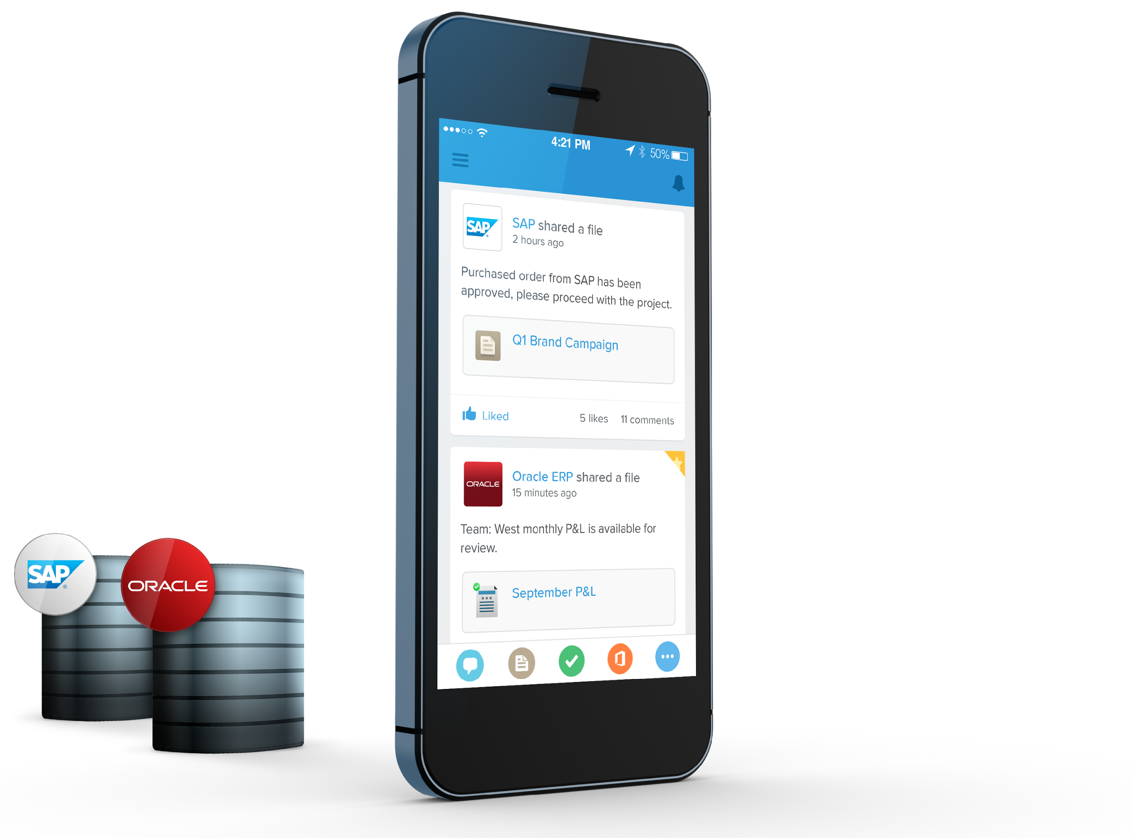
Lightning Connect
Integrate external data faster
Access to external data with point-and-click simplicity
Incorporate external data into Salesforce in real-time, not copying data
Not storing data alleviates data residency concerns
Dramatically reduces time to unlock back-office systems
Available in DE orgs; add-on license required in Production orgs
Notes:
Business apps rarely stand alone. They are often connected to existing backend systems, many of which are critical for running their business.
Many of our customers are using salesforce as an agility layer above these existing systems. To be able to connect to their system easily is incredibly important.
Lightning connect makes integration fast with point & click and by treating external data like native Salesforce data within the Platform.
Key Points:
Connect allows external data to be accessed by Salesforce applications
Adding a new data source takes only a few minutes
Data is pulled in real time, not cached or stored, meaning that apps are always working with the most up-to-date data
Connect uses the open ODATA standard to pull data from any source; our partners can make data easily accessible in ODATA format

Slide 12
Lightning Connect
Demo
Connect
Notes:
Let’s learn more about each of these tools, at a high level, before drilling into each one for more details and the hands on tutorial.
Let’s start with Lightning Connect…

Slide 13
Introducing Lightning Process Builder
Process Builder
Component Framework
App Builder
Connect
Notes:
Now let’s talk about Lightning Process Builder…

Slide 14

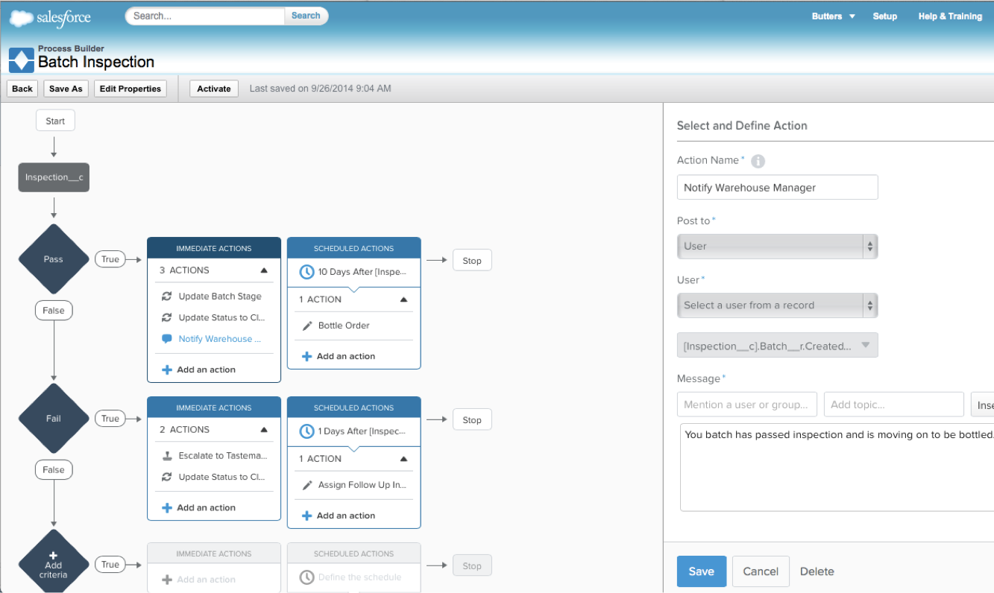
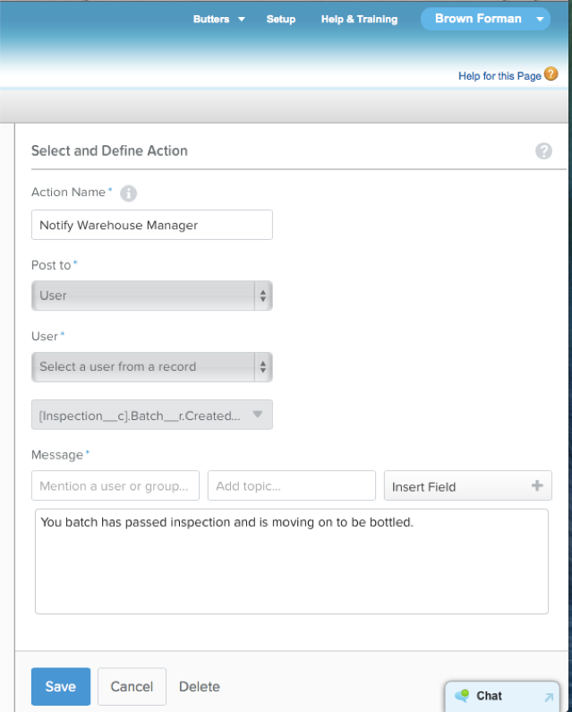
Lightning Process Builder
Automate business faster
Create processes using visual layout
Point-and-click development
Manage multiple process paths in ONE place
Create “headless flows”
Collaborate with business owners
Replace many basic Apex triggers
DE, EE and up
Notes:
To do that we use Lightning Process Builder.
PB allows you to Do more with clicks: e.g., create records with clicks vs. classic workflow that would require a code change.
Business users can now visually create process paths, choose when these processes start, and what actions to take.
Create headless flows -> “If workflow and visual flow were to have a baby, it would be lightning process builder”. Lightning Process Builder creates headless flows, which means you can create actionable flow charts that are kicked off in a similar fashion to how workflow rules kick off. Traditionally with flows (ie Visual Workflow) you had to use a wizard-like user interface invoke actions, but these conditional actions can go on behind the scenes off user interactions with their data.

Slide 15
Introducing Lightning Components
Process Builder
Component Framework
App Builder
Connect
Notes:
Next let’s get into Lightning Components, for the coders in the audience…

Slide 16

Component Frameworks Are The Future
All leading platform companies are investing in component frameworks
Google
Polymer
Facebook
React
Salesforce
Lightning
Twitter
Flight
Mozilla
Brick
Notes:
The need to allow developers to build sustainable, and re-usable components is a key to the future of app development. All of the leading platform companies are investing in component frameworks. While frameworks like Polymer and Flight are awesome consumer app frameworks, in the world of mobile business apps Lightning is the only proven enterprise component framework. This is not to say we are competing, it is increasingly becoming the standard across all industries.
It is important to note that Lightning is the ONLY enterprise component framework that supports enterprise requirements like security, localization and more.

Slide 17


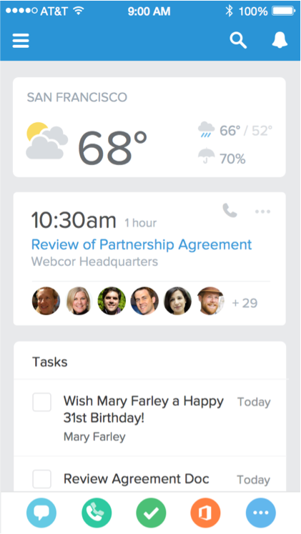
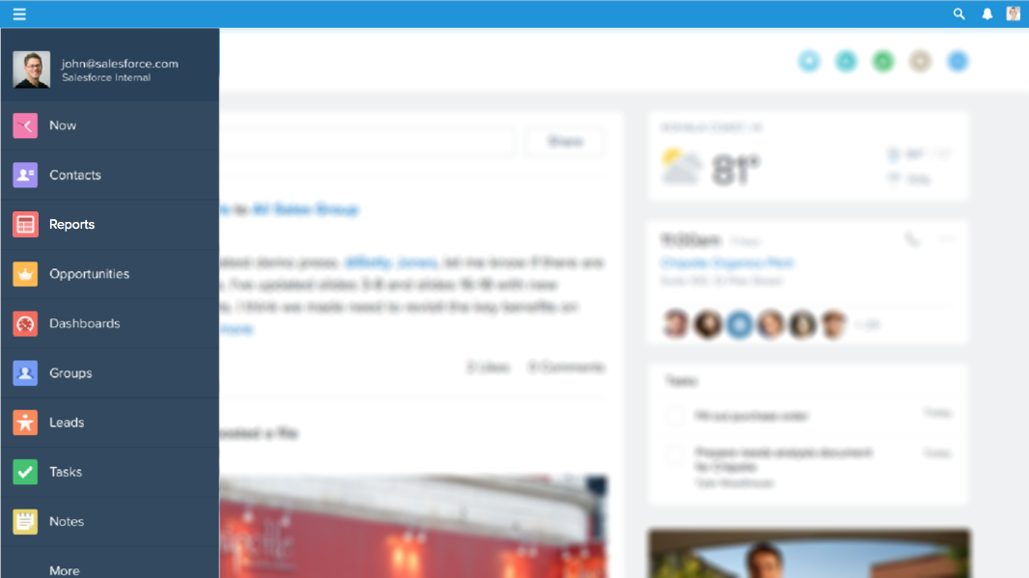
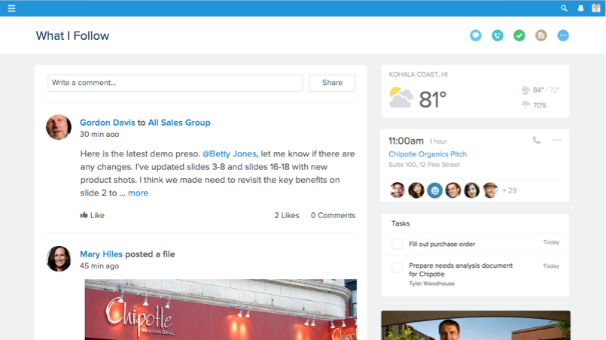
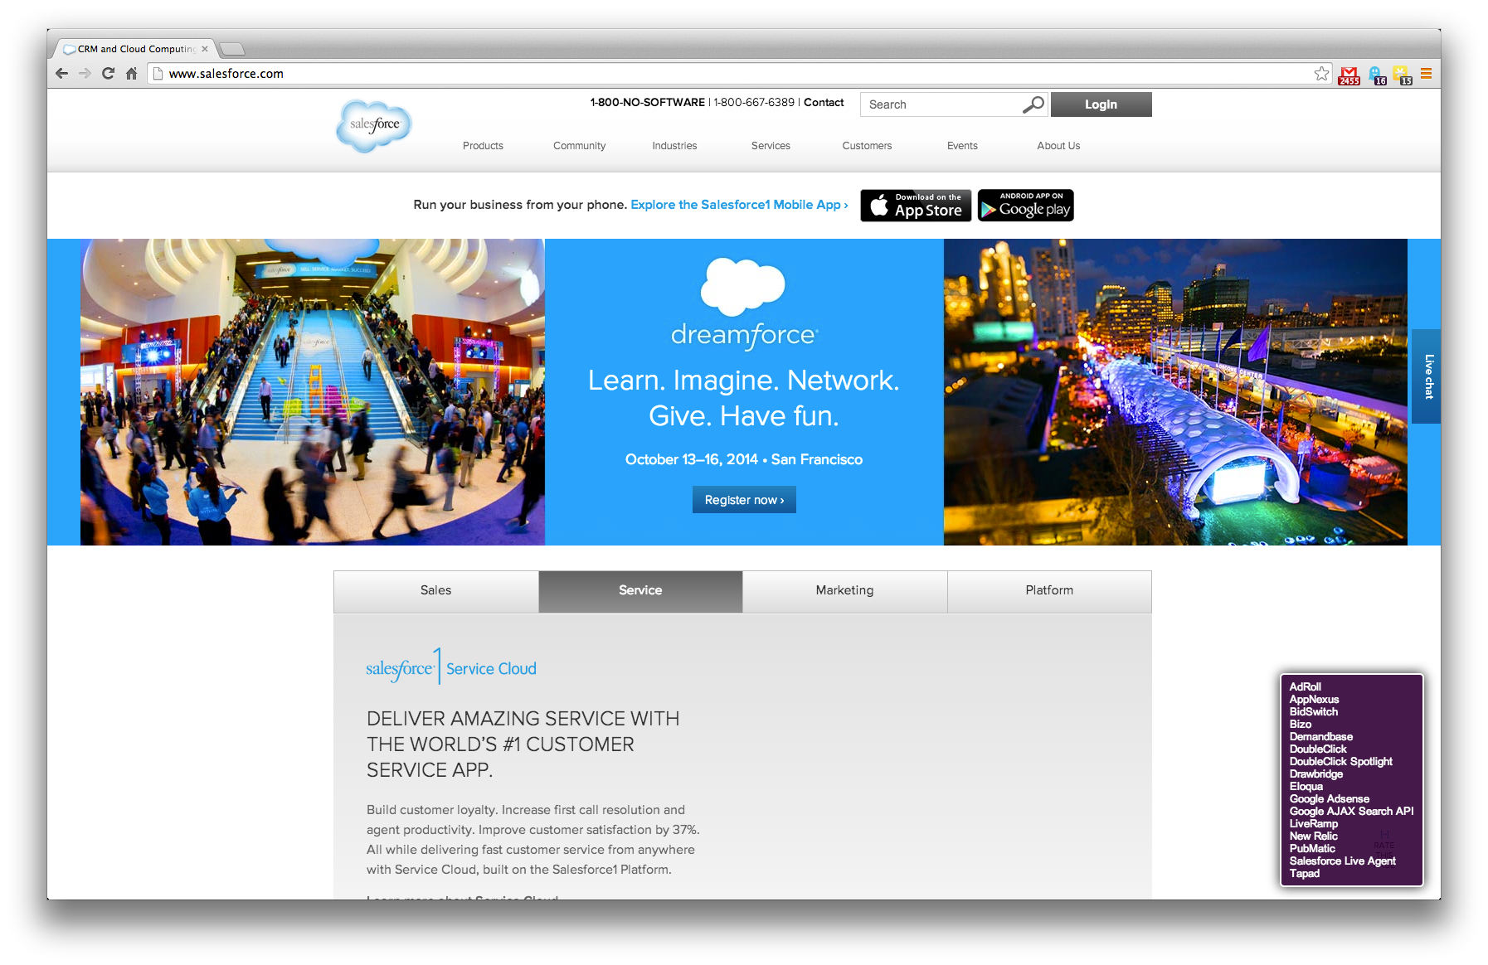

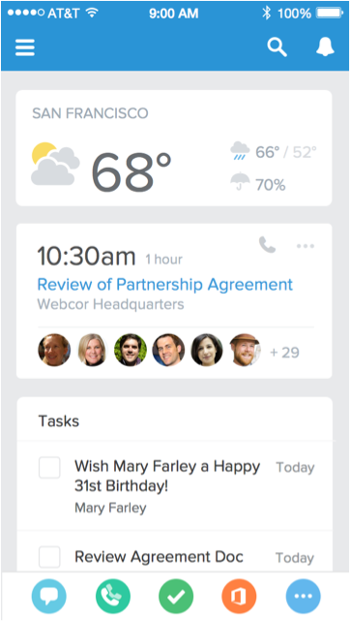
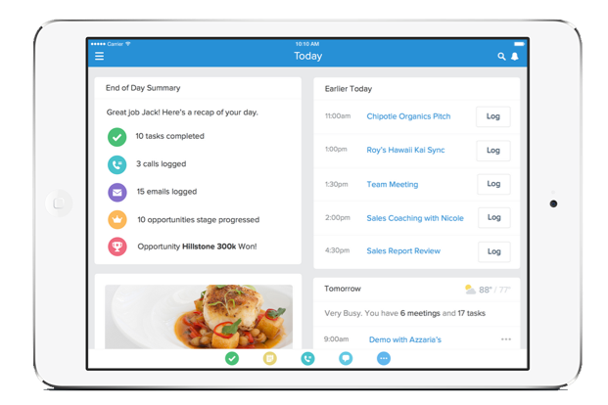

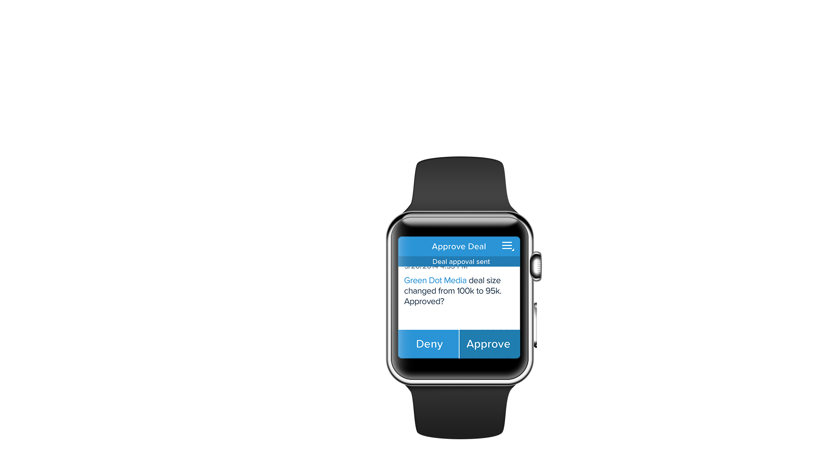

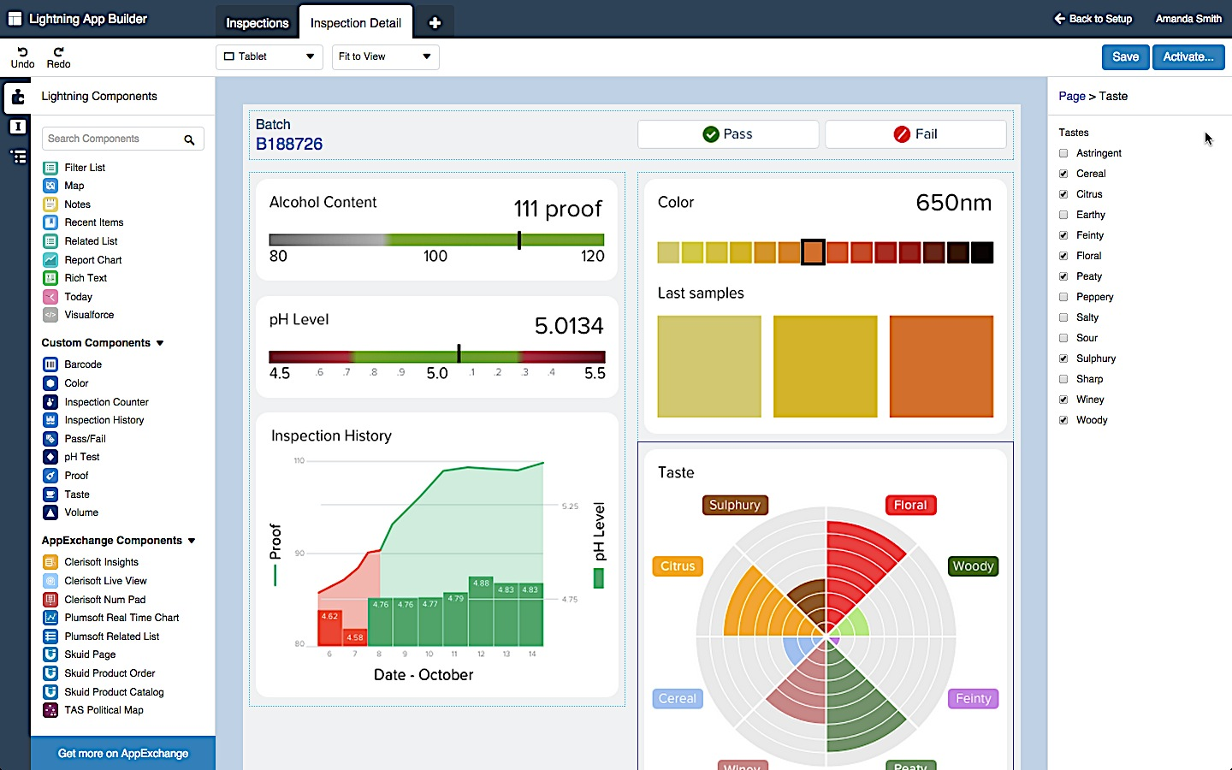

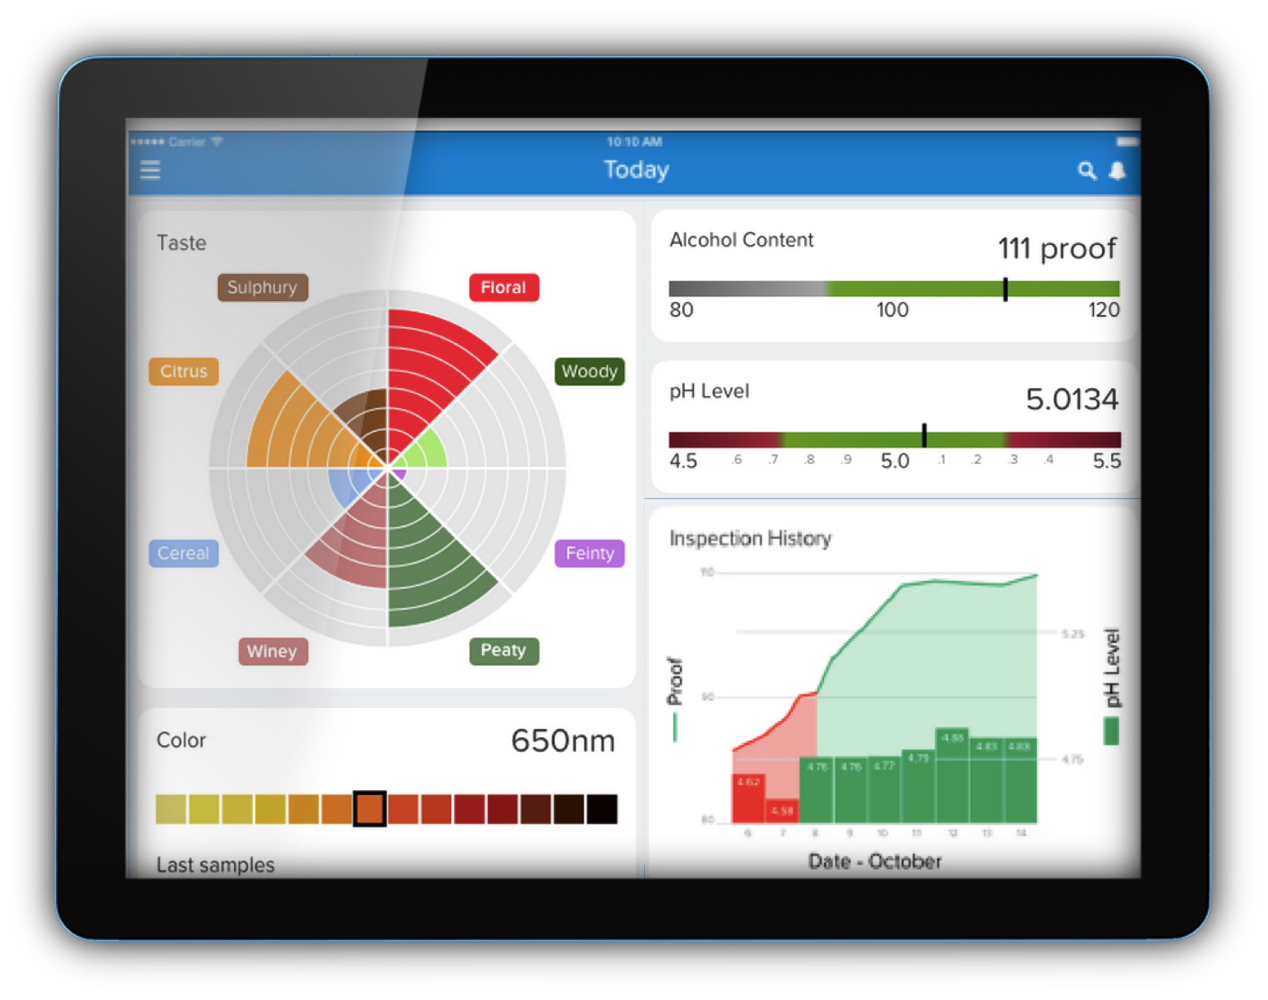

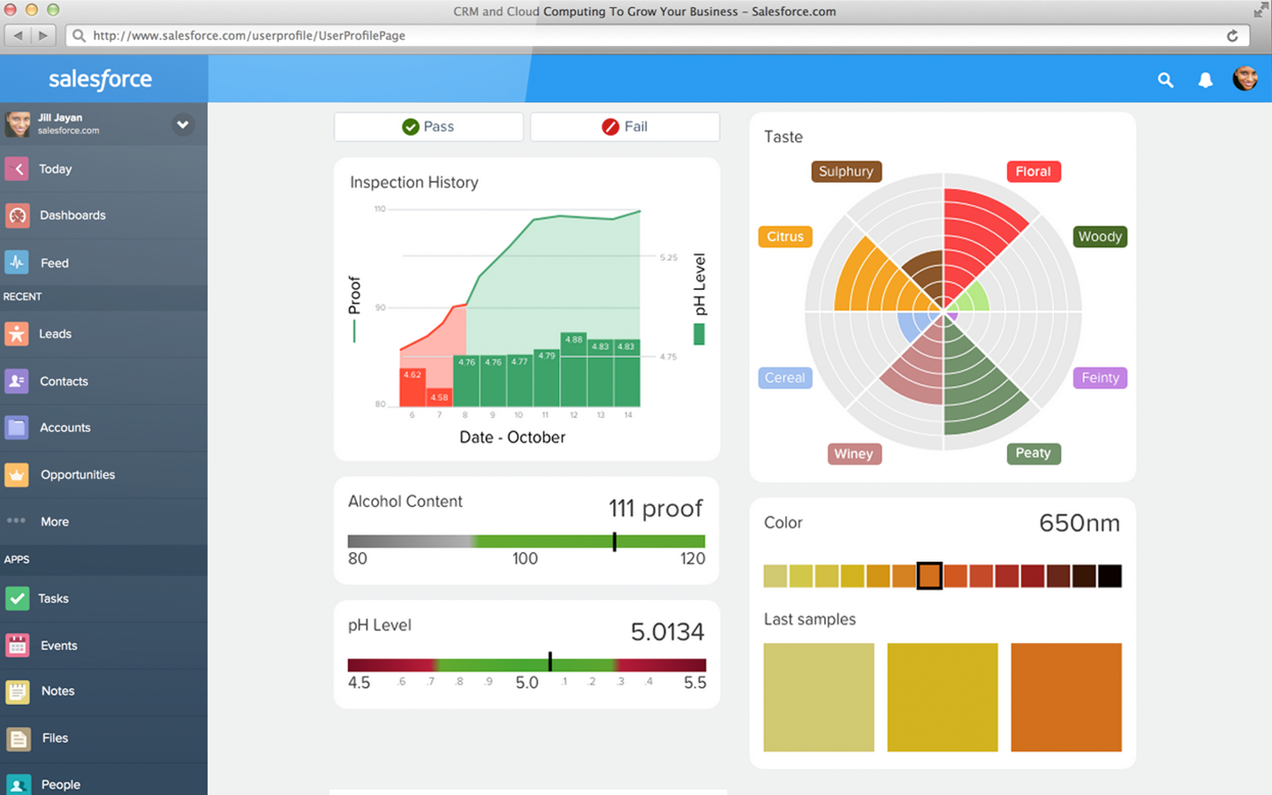
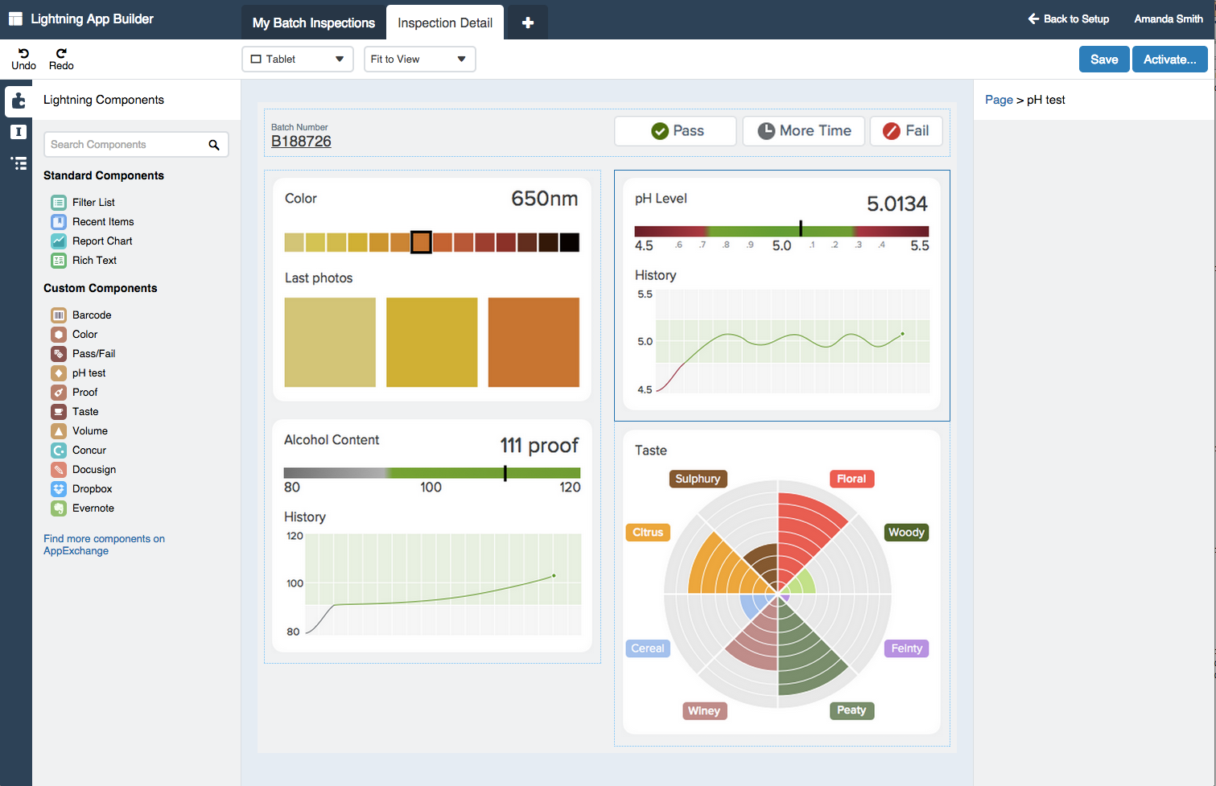
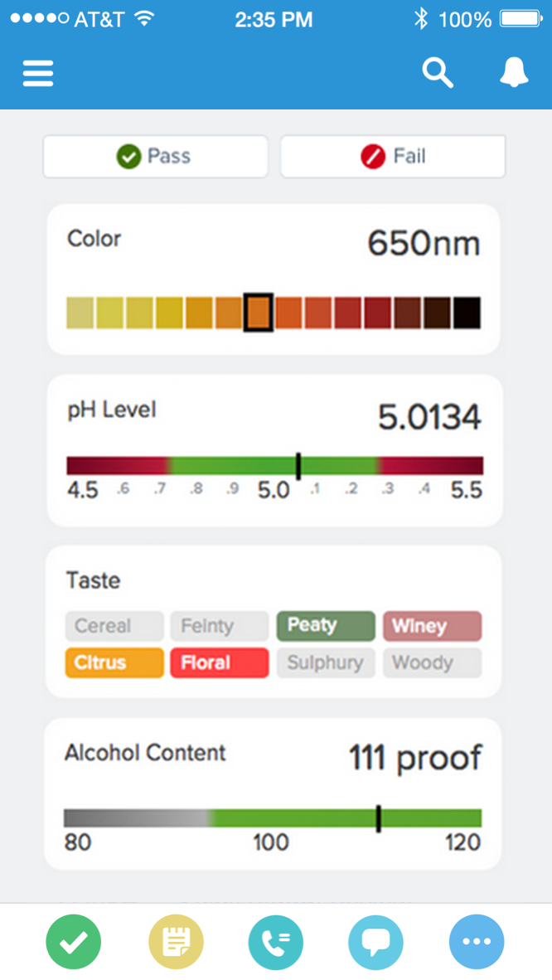
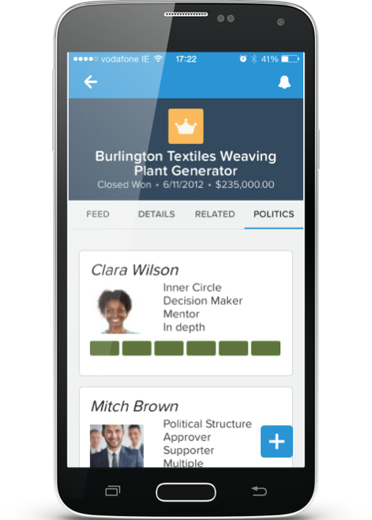
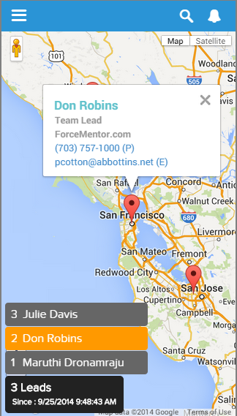
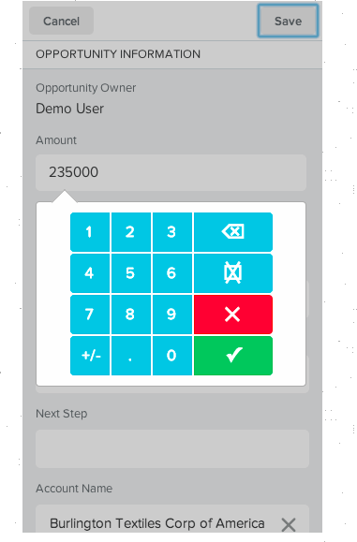
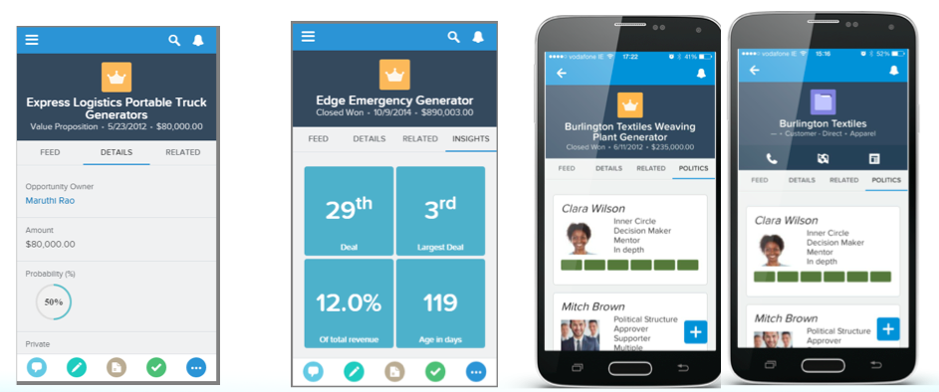
Lightning Component Framework
Standard Components Built by Salesforce
Tasks
Left nav
Publisher bar
Feed items
Custom Components Built by customer developers
Pass/Fail
Sliders
Multi-view charts
AppExchange Components Built by Partners
Custom charts
Data entry tools
Custom data layout
Dynamic maps
Notes:
This component-based approach allows us to do is start to think of components vs. apps for greater flexibility. It changes how you, and we, can build apps on the Salesforce1 Platform
The Salesforce1 app is created with components, and over time more and more of those will be available to developers and admins to use to build new app.
You can create completely custom components using javascript, css, and build to salesforce data (including data exposed via lightning connect)
And, just like thousands of customers are already doing with Apps in the AppExchange, you will be able to compose apps based on lightning components from the new Component Exchange.

Slide 18
Introducing Lightning Components
Code!
Component Framework
Notes:
Next let’s get into Lightning Components, for the coders in the audience…

Slide 19
Introducing Lightning App Builder
Process Builder
Component Framework
App Builder
Connect
Notes:
And last but definitely not least, the Lightning App Builder…

Slide 20

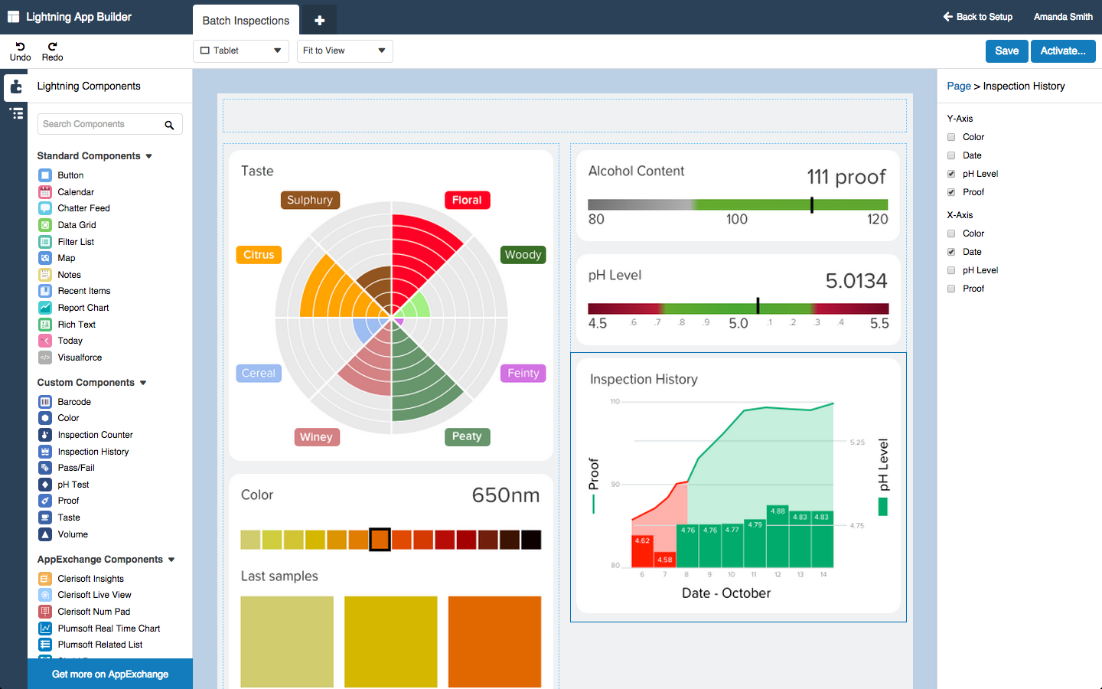
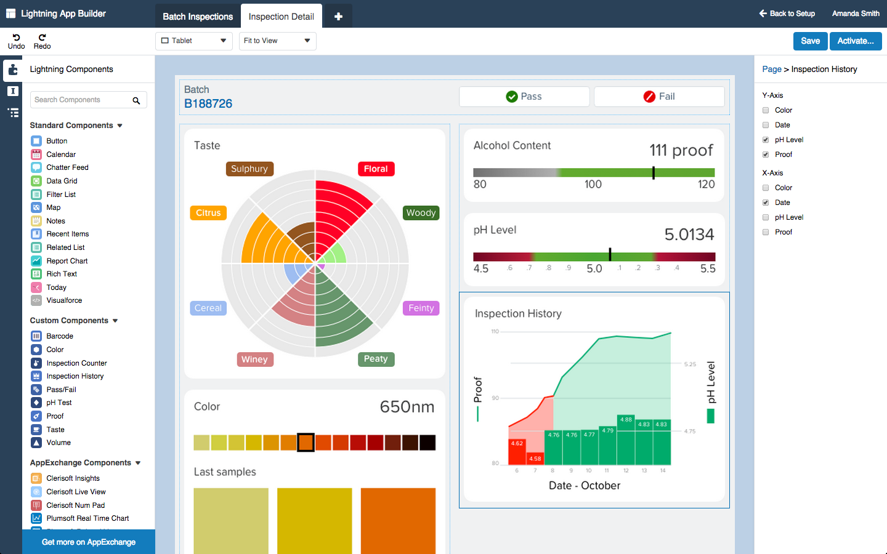













Lightning App Builder
Now anyone can build apps faster
Drag & Drop Build with standard, custom & partner Lightning Components
Any Device Design apps for every screen from one canvas
Notes:
Add component exchange
Lightning App Builder is designed to solve the app gap – by making everyone in your organization a mobile app developer.
We provide a rich, intuative interface to drag and drop lightning components to compose apps without writing code. And have it run on every device.
You can use our components, existing salesforce assets – reports and even visualforce pages
And, because of lightning components, all of your custom components, and even those of partners, will show up in the design time palette.
But you know what, App Builder is just best to show!

Slide 21
Demo:
Lightning Overview
Notes:
Now, I want to show you one application that includes ALL of these things. I’m Intentionally not going to show you how it was made, just want to focus on what is now possible to build with clicks, and where you still need code.
The demo application is a Travel & Expenses app that improves an employee’s experience tracking a business trip. We’ll request a trip, log expenses, and then review the expense Payments.
Presenter Note: This is a demo of end user app, not showing Setup yet – that comes later. Demo setup steps and script: https://org62.my.salesforce.com/sfc/p/000000000062/a/300000009uzs/6JdWGYjeaGfWZr3mWMbQ0.0mf85b3yPsthA4hvZj.o8

Slide 22
Hands-on
Notes:
Starting pitching again as if in workshop
OK, time to get hands on with each of these technologies.
[the next 4 sections can we delivered together or separately, depending on time/audience]

Slide 23
Create a new Spring ’15 DE Org
Use this link to create a new Spring ‘15 Developer Edition (DE) org for the tutorials
(you only need one)
http://bit.ly/lightning-org
Notes:
This signup link will make a DE org with the metadata, sample data, and org permissions you need for the tutorials.
If people use the regular signup link they can still do the Connect, Process Builder, ad Components tutorials, but will need to install each package individually in those. They will not be able to do the App Builder tutorial because they will not have App Builder enabled.

Slide 24
Process Builder
Component Framework
App Builder
Connect
Notes:
Lets start with the data, and lightning connect. Before you get hands on, let’s cover a few more details.

Slide 25



What External Data Sources are Supported?
Any Data Sources that can publish data in Open Data (OData) 2.0 protocol
Commercial Packages
SAP Netweaver Gateway
Microsoft SQL Server, Dynamics CRM/NAV, Azure Table Services
IBM Websphere exTreme Scale
Heroku Connect External Objects
DIY Data Producer
.Net WCF Data Services, Java (Apache Olingo, odata4j), NodeJS
Many more via partners
Dell Boomi, Informatica, Jitterbit, MuleSoft, Progressive, SoftwareAG
Notes:
This is a lot of information, but the main takeaway is that there are a lot of data sources that can publish data in the Odata protocol, and a lot of partners in this space.

Slide 26
External Objects Work Like Custom Objects
Tabs
List Views
Detail Pages
Chatter Feeds
Visualforce pages with standard or custom controllers
Apex SObject types
REST/SOAP API access
SOQL and SOSL queries from Apex or API
Available on Salesforce1 Mobile Platform
Notes:
If you are familiar with Custom Objects, then you already know how to work with External Objects.

Slide 27
Lightning Connect Roadmap
Read-only access is GA in Spring ‘15
Pilot in Spring ’15
Read/write capability
Real-time cross-org access
Apex Connector library to develop custom connectors
FUTURE*
OData 4.0
Support for triggers
Custom Reports for External Objects
* Safe Harbor
Notes:
Lightning Connect in it’s Read-Only form is currently GA, but in Spring ’15 Salesforce is piloting read/write. Yes, this includes cross-org access between Salesforce orgs(something a lot of customers want to do). Further out on the roadmap is support for triggers and reports.

Slide 28
Other External Object Limitations
Formula and Roll-up Summary Fields
Triggers, Workflow, Approvals, Process
Validation Rules
Field History Tracking
Notes, Attachments
Notes:
Keep these other limitations in mind as you work with external objects.

Slide 29
Walkthrough: Lightning Connect
Notes:
Let’s take a quick look at what’s new in Setup to support Lighting Connect.
[see demo script: https://org62.my.salesforce.com/sfc/p/000000000062/a/300000009uzs/6JdWGYjeaGfWZr3mWMbQ0.0mf85b3yPsthA4hvZj.o8]

Slide 30
Tutorial: Lightning Connect
Start at Module 3
bit.ly/lightning-connect-tutorial
Notes:
http://developerforce.github.io/lightning-connect-tutorial/index.html
Estimated time to complete: 15 mins
Mention to audience: Follow the GitHub repository to keep up with any updates or tutorial changes.

Slide 31
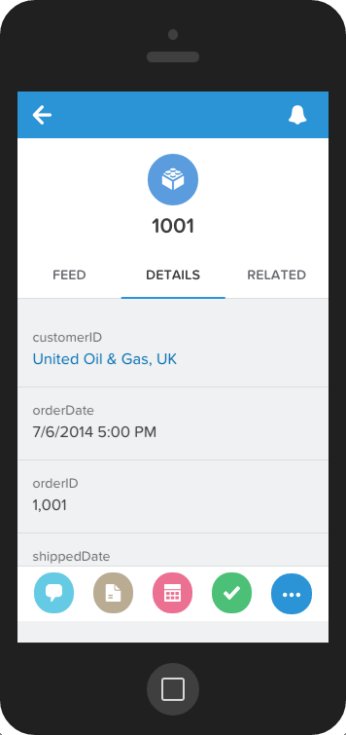
Notes:
Alright, everyone should have something that looks like this! Great job.
Connect makes its it easier to access data in existing systems like Oracle, SAP, and thanks to our partners, dozens of other critical business systems.

Slide 32
Process Builder
Component Framework
App Builder
Connect
Notes:
But now that you have the data, what do you do with it? You want to build new streamlined business processes without hardcoding this logic.

Slide 33









Process Builder
New Actions
Next Generation Workflow
Workflow Rules
Multiple “Rules” in 1 process
More Flexibility
Graphical Interface
Notes:
The Process Builder is the next generation of workflow rules.
You can think of it as WF rules + more actions, more flexibility to operate across objects, the ability to combine rules into a single process
With graphical interface to build & view your process

Slide 34
With Process Builder You Can….
Create a record (related OR unrelated to the criteria object)
Update fields on ANY related record
Launch a trigger-ready Flow
Send an email
Post to Chatter
Submit for approval (or trigger existing approval process)
Execute Apex Code
Notes:
With Process Builder You Can’t…
- create tasks
- Create outbound messages

Slide 35
Process Builder Limitations
Create Tasks
Send Outbound Messages
Design Screen Flows
Use Workflow Rules
Use Visual Workflow
Notes:
Keep these other limitations in mind as you work with Process Builder – if your requirements include these, then use Workflow Rules.

Slide 36
Why does it say “Flow” sometimes?
Behind the scenes, a Process Builder process is a Flow
Same engine as Visual Workflow
Surfaces in
End user error messages
Packaging
Maybe others…
Notes:
Those of you who have already worked with Process Builder might have noticed that sometimes the word Flow is used. That’s because Process Builder is creating Flows, behind the scenes. The platform sees them as the same thing, so error messages will use the word Flow, and when you package a Process Builder process, it is listed as a Flow, not a process. There might be others, so don’t let that throw you off – just remember they are the technically the same to the platform.

Slide 37
Walkthrough: Process Builder
Notes:
Let’s take a quick look at the process builder, to get familiar with the user interface and what you can do.
[see demo script: https://org62.my.salesforce.com/sfc/p/000000000062/a/300000009uzs/6JdWGYjeaGfWZr3mWMbQ0.0mf85b3yPsthA4hvZj.o8]

Slide 38
Tutorial: Process Builder
Start at Module 3
http://bit.ly/process_lightning_tutorial
Notes:
http://developerforce.github.io/lightning-process-builder-tutorial/
Estmated time to complete: 20 mins
Mention to audience: Follow the GitHub repository to keep up with any updates or tutorial changes.

Slide 39
Notes:
Alright, everyone should have something that looks like this! Great job.
Process Builder lets Admins, Business Analysts, and even Developers automate complex business processes, faster.

Slide 40
Process Builder
Component Framework
App Builder
Connect
Notes:
So far we’ve seen how we can quickly integrate data with Lightning Connect, streamline business processes with Lightning PB, but what about developers? How can we make it easier to build and share apps too?
We do this with the Lightning Component Framework.
The Lightning Component Framework is a web component framework designed for the enterprise that allows developers to rapidly create secure and trusted components and apps that run on any devices and optimized for mobile.

Slide 41
What can I build with Lightning Components?
Lightning Component Tabs for Salesforce1 Mobile App (BETA)
Single or multiple “page” apps available in “Stage Left”
implements=“force:appHostable”
This is what you’re building in the tutorial!
Custom Components for Lightning App Builder (PILOT)
Components designed for ease-of-use via tools, available in the palette
implements=“flexipage:availableForAllPageTypes”
You’ll see this in the next section!
Notes:
Lightning Components are reusable, fine-grained, and can be nested inside each other. This gives you the felxibility to build big integrated systems like Salesforce Sales Cloud or specific “point” application like capturing feedback or providing dashboard data.
Lightning Components are in Beta, so you will have to enable them in your DE org (it’s a single checkbox, you’ve got this).
[click]
In the overview demo you saw Expense Home, which was a Lightning Component Tab. That’s where you use the Tab mechanism to surface a single component in Salesforce1 Mobile. The component must be “force:appHostable” to do this. In the Tutorial, you will surface Lightning Components in Salesforce1 this way.
[lcick]
You also saw the Expense Form, which was a very simple single-page Lighting App (actually known as a Lightning Page); you will do more with custom components and Lightning App Builder in the next section.

Slide 42
What else?
Lighting Applications
Full-page Lighting Component-based applications
URL-addressable
Lightning Extensions (Limited Pilot)
Override the default components with custom components
Notes:
There are two other wasys to build with Lightning Components, which we are not going into in this workshop, but I just want to tell you about.
[click]
You can build standalone Lightning Apps – these can be small or large (the Process Builder is a standalone Lightning App). We are not focusing on this type of app in this workshop because building a standalone app means you are stepping out of the Salesforce1 Mobile user interface and rolling your own everything.
[click]
Lightning Extensions allow you to override the default Salesforce1 Mobile App components with custom components, but we are not covering them in this Workshop. They are awesome but they are in limited pilot.

Slide 43


Lightning Components Handle User Interactions
Configure Attributes
Set color
Set object
Get user
Listen for Events
Fire Events
Data updated
Screen tapped
Another component changed
Network offline
Record saved
List scrolled
Save offline
Color changed
Notes:
So what is a Lightning component? In further webinars in this series we will do a much deeper dive into how to build components, but it is helpful to think of lightning components as handling user interactions:
They can listen for events on a page (screen tapped, another component changed) or environment (network went offline)
Be configured for user interactions – set color, bind to data etc.
And react to events by firing off some sort of change notification

Slide 44
Lightning Components Improve Developer Productivity
Package 1
Package 2
Components are bundles of resources
Bundles enable reusability, share ability, and extensibility
Components can be used to compose apps
App1
App2
Cmp1
Cmp3
Cmp2
Cmp2
Cmp2
App1
Definition : html
Style : css
Helper : js
Controller : js
Component(s)
EventHandler : js
APP or COMPONENT BUNDLE
Notes:
Any individual app or component has a directly associated bundle of resources. These bundles contain definitions for self contained HTML, CSS, and JS.
Apps consist of one or many component, and be built both declaratively (as well see soon) and with code. Components can be used to extend the Salesforce1 mobile environment be composed into a standalone Lightning App comprised of one or more components. These components can be used across multiple apps, inheriting the characteristics of app bundle, and can also be shared via public or private packaging across orgs.

Slide 45
Visualforce and Lightning Components Full FAQ at: https://developer.salesforce.com/page/Lightning_FAQ
What’s the difference?
Visualforce components are page-centric and most of the work is done on the server. Lightning is designed from the component up, rather than having the concept of a page as its fundamental unit. Lightning Components are client-side centric, which makes them more dynamic and mobile friendly.
Where can I use what?
Currently you can only use Lightning Components in the Salesforce1 Mobile App or a standalone app, not in the Salesforce desktop UI.
Currently you can use Visualforce inside a Lightning App, but not a Lightning Component inside Visualforce.
Notes:
A lot of you may have questions about Visualforce and Lightning Components. There is a technical FAQ document on our Developer site, but let’s hit a few here. First, let’s be clear that Lightning Components are not replacing Visualforce. Your existing Visualforce pages will continue to be supported in the current Salesforce UI.
------In case people ask ------
Q: Will Lightning Components work inside Visualforce some day?
A: Not at this time, and Salesforce is not commenting publicly about our release plans.
Q: After Lightning Components are GA, when would it still be appropriate to use Visualforce?
A: Visualforce provides the facility for delivering template-driven web pages and email messages. In addition, developers wishing to simply utilize a basic container and maintain more control over the lifecycle of the request may choose Visualforce pages. Finally, organizations that can’t use Apex code can’t use Lightning Components, but they can use Visualforce.

Slide 46
Walkthrough: Lightning Components
Notes:
Let’s do a quick walkthrough to see what’s new in the Dev Console and cover some fundamental aspects of Lightning Components.
[see demo script: https://org62.my.salesforce.com/sfc/p/000000000062/a/300000009uzs/6JdWGYjeaGfWZr3mWMbQ0.0mf85b3yPsthA4hvZj.o8]

Slide 47
Tutorial: Lightning Components
Start at Module 2
bit.ly/lightning-components-tutorial
Notes:
http://developerforce.github.io/lightning-components-tutorial
Estimated time to complete: 30 mins
Mention to audience: Follow the GitHub repository to keep up with any updates or tutorial changes.

Slide 48
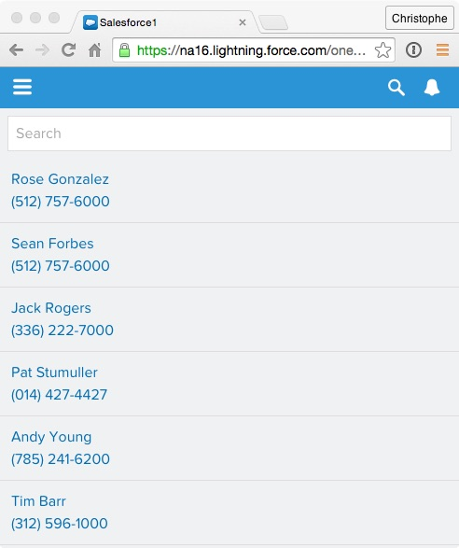
Notes:
Alright, everyone should have something that looks like this! Great job.
Lightning Components are how Developers deliver reusable business functionality.

Slide 49
Process Builder
Component Framework
App Builder
Connect
Notes:
Ok, so we’ve seen how we can connect to backend systems with Lightning Connect
How we can streamline business processes with Lightning PB
And how to create components and use those components to compose apps with Lightning Component Framework.
We’ve already seen with the Salesforce1 app how we, at Salesforce, are helping customers run their business on their phone. But what about custom mobile apps? Do you need specialist mobile developers?
Who’s org is good at building mobile apps? [hands up, or not – discussion about how it’s hard to build native mobile apps, retool devs]
With lightning app builder, everyone can now build these mobile apps, fast.

Slide 50
What can I build?
Single Page Applications
Drill down to existing standard pages
Expose Global Actions for more interactivity
Dashboard-style Applications
Sales Leaderboard
“Point” Applications to solve a particular task
Upload expense receipt
Notes:
One of the first questions with the App Builder, especially in it’s Pilot state, is what can I build? You’ll see in your new DE org that there are 5 standard components delivered, and as you just saw in the Component Tutorial, you can combine components and they can interact with each other in an application.
Right now, you can only make a Single Page Application in the Lightning App Builder. But, that application can work seamlessly with the rest of the Salesforce1 Mobile App and you can drill from a record in your app to the standard pages. You can also add Global Actions, as you will see in the tutorial.
The two patterns we’ve seen in the Pilot so far are…
Dashboard-style Applications: the app you’ll build in the tutorial is this type of app – one place for an employee to see the big picture across objects.
2. “Point” Applications to solve a particular task, for example, uploading an expense receipt

Slide 51
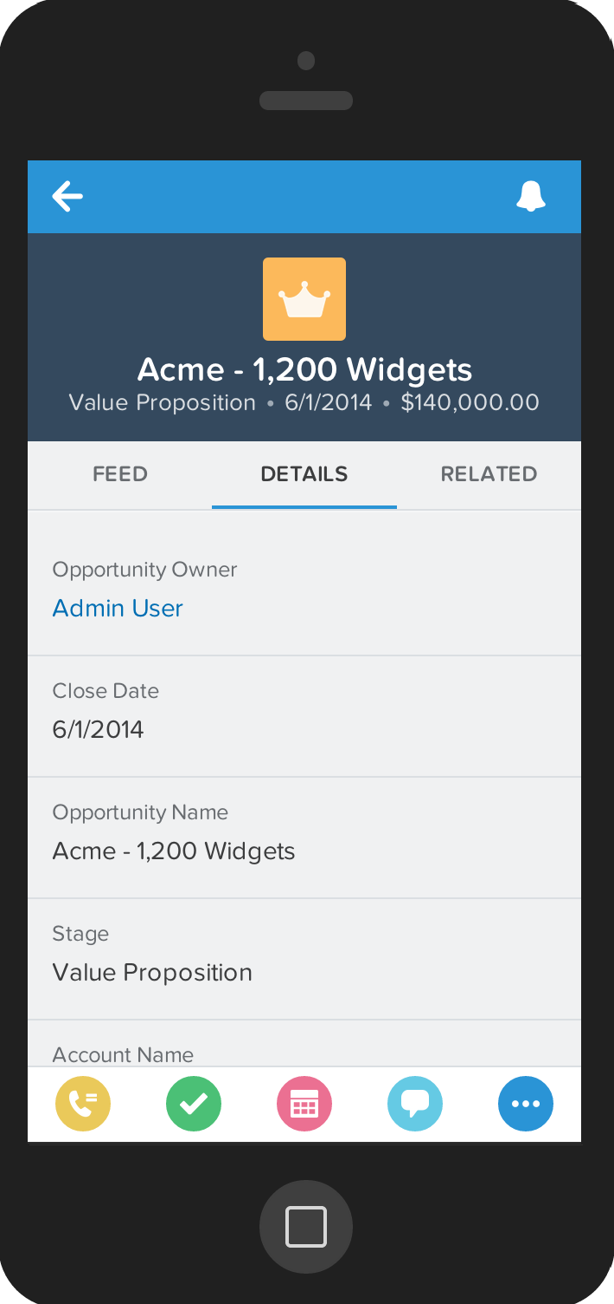
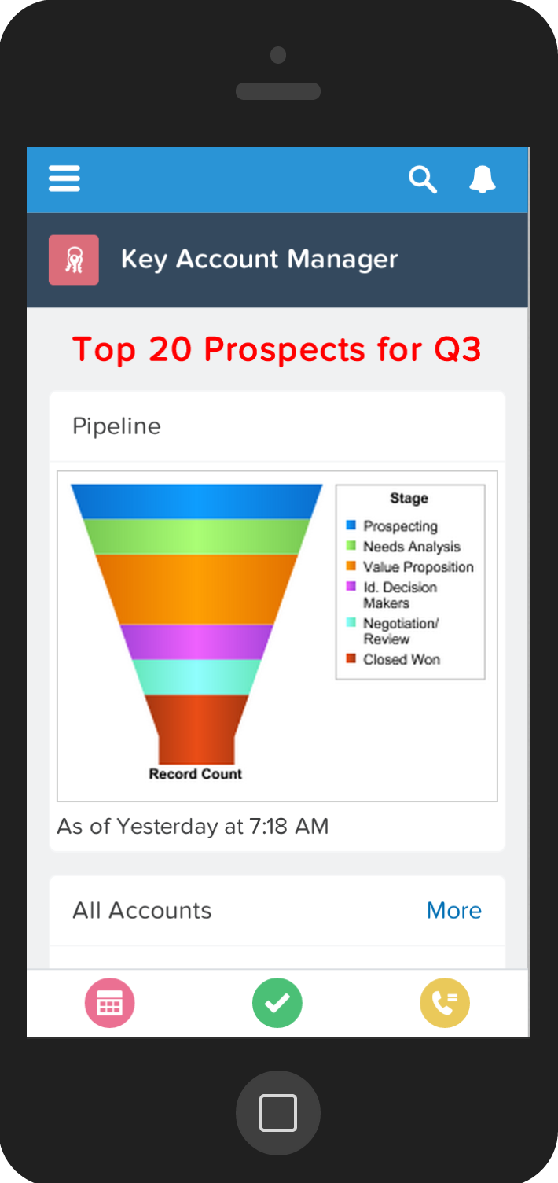
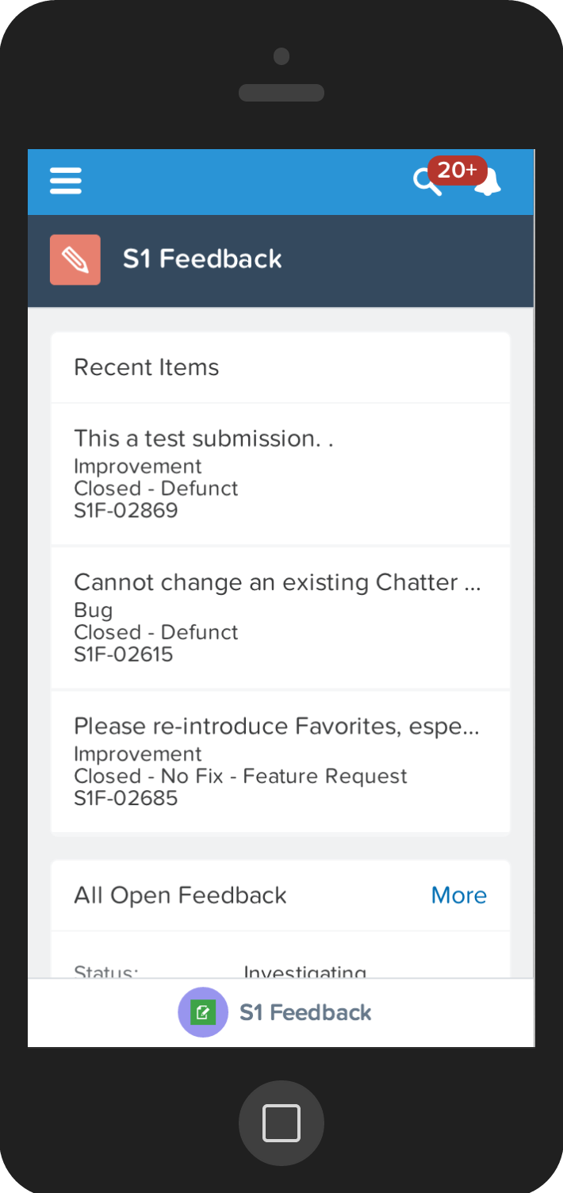
Apps in Salesforce1 Mobile
Notes:
Here are just a few examples of Apps running in Salesforce1
Apps can be big integrated systems like Salesforce Sales Cloud [the app on the left] or they can be specific “point” application providing dashboard data [app in the middle] or like capturing feedback [app on the right].
Other examples of apps you might build in App Builder:
Pipeline Tracker:
Monitor leads and opportunities in one centralized screen to show lists and charts of active leads and top opptys
Travel and Event Tracker:
Keep track of upcoming trips and events; potentially tie into expenses; great when it includes a map view
Support Tracker:
Keep track of open cases, stats on case management, maybe have list of active agents, etc

Slide 52
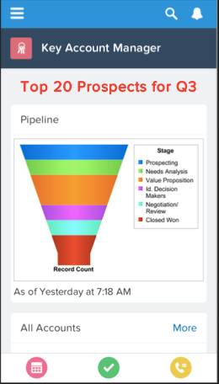
What’s in an App?
Lightning
Page
Lightning
Components
Global Actions
Notes:
When you build an App in Lightning App Builder, it has 3 parts. Today, App Builder only supports single-page apps, so what you are really building is a Lightning Page. That Lightning Page can include one or more standard or custom Lightning Components [in this example, we see a Report Chart component and a List Filter component – both are standard components]. Lighting Pages also support Global Actions, and you choose which actions to display on your page in the Lightning App Builder.
An app can come in many forms. Apps as we traditionally know them in Salesforce1 are tabs containing data. With Lightning, you can build apps using the component framework, composing standard or custom components within an app using either drag and drop tools or code.

Slide 53
Walkthrough: Lightning App Builder
Notes:
The easiest way to tell you about the Lightning App Builder is just to show it to you.
[see demo script: https://org62.my.salesforce.com/sfc/p/000000000062/a/300000009uzs/6JdWGYjeaGfWZr3mWMbQ0.0mf85b3yPsthA4hvZj.o8]

Slide 54
Tutorial: Lightning App Builder
Start at Module 3
http://bit.ly/app_builder_lightning
Notes:
http://developerforce.github.io/lightning-app-builder-tutorial/
Estimated time to complete: 20 mins
Start at Module 2, Step 4 (note: there are a few contacts with location already populated in various regions, but this is a good step so that they understand it; also a place people get stuck because lat/long is not a common language for everyone) :-)
Mention to audience: Follow the GitHub repository to keep up with any updates or tutorial changes.

Slide 55
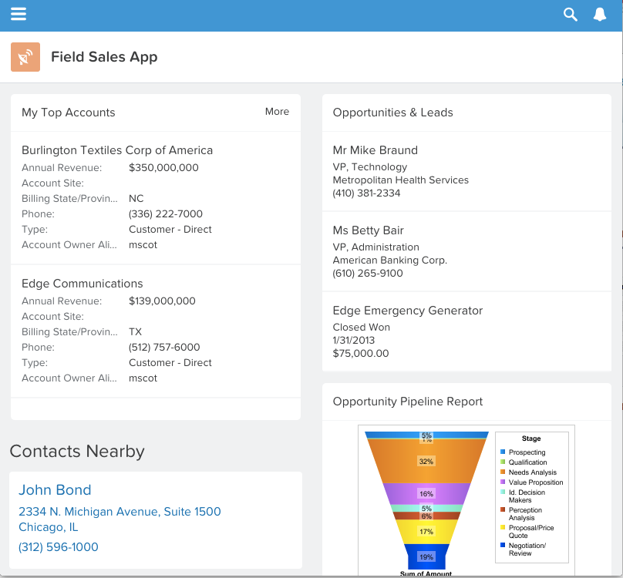
Notes:
Alright, everyone should have something that looks like this! Great job.
Lightning App Builder is how anyone can build a mobile business app, fast.

Slide 56
#golightningfast
Notes:
So there you have it. Now you are ready to go lightning fast with all four of these new tools on the Salesforce1 Platform!
OK, maybe not totally ready...let’s talk about some next steps and resources so that you can dig deeper.

Slide 57
Next Steps

Slide 58

Pave Your Own Trail
http://developer.salesforce.com/trailhead
Notes:
For more hands on, go online to Trailhead – great modules for all sorts of things, but especially two Lightning modules: Lightning Components(new) and Process Automation (updated: now covers Lightning Process Builder AND Workflow Rules and Flow).

Slide 59
Lightning Deep Dive Webinars
Lightning App Builder
Lightning Component Framework
Lightning Process Builder
Lightning Connect
http://developer.salesforce.com/calendar
Notes:
Check the Developer Webinar Calendar for these 4 deep dive webinars coming in March and April. We’ll spend a full hour on each topic and hear straight from the Product Managers.

Slide 60
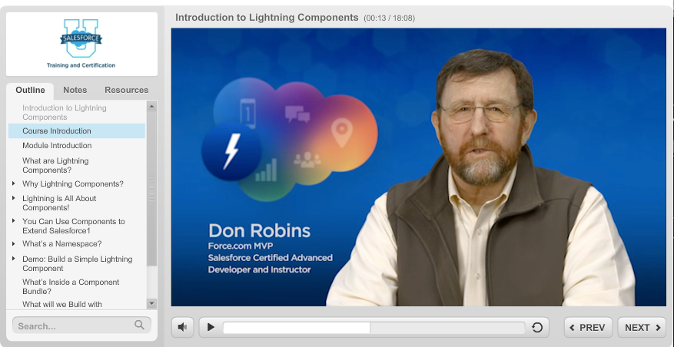
Go to success.salesforce.com, Help & Training
Search for the Creating Lightning Components course
Notes:
To get a deeper dive into Lightning Components, go online to Salesforce Help & Training in the Success Community and search for Creating Lightning Components. This new Salesforce University course is taught by Force.com MVP, Don Robbins.

Slide 61
Want to build components? Check out the docs!
https://login.salesforce.com/auradocs
Login with an org that has Lightning enabled
Component, app, interface, and event reference guide
Reference JavaScript API
Samplecode
Notes:
https://login.salesforce.com/auradocs

Slide 62
Questions?
Success Community Chatter Groups
Official: Lightning Connect
Official: Salesforce Workflow Automation
For questions about Lightning Process Builder
Official: Lightning App Builder
Notes:
We can take questions now, and also you can post questions to these internal chatter groups as you dig further into each area of Lightning.

Slide 63
Thank You

Slide 64
Appendix

Slide 65
Process Builder Considerations
Process Builder is a client to Visual Workflow. It will respect both Apex Governor Limits and Process Limits.
Details on Limits: https://help.salesforce.com/HTViewHelpDoc?id=process_limits.htm&language=en_US
Processes can evaluate records up to five times in a single transaction if another process, workflow rule, or flow updates the record in the same transaction.
If you create processes to replace any workflow rules, make sure you delete those workflow rules when you activate the equivalent processes.

Slide 66
Process Builder Considerations, con’t.
Processes can evaluate a record anytime a record is saved or created. However, processes that are created after records are saved don’t evaluate those records retroactive
Picklist fields are evaluated as text fields in the Process Builder.
Full Details on Process Builder Considerations: https://help.salesforce.com/HTViewHelpDoc?id=process_considerations.htm&language=en_US

Slide 67
Process Builder: What’s New in Spring 15?
Create versions of a process
Trigger a process multiple times in a single transaction
Determine whether specific fields changed
Customize condition logic in process builder
Call Apex method from a process
Updated and more efficient UI
Notes:
Create your processes using a convenient visual layout with point-and-click efficiency. • Create your whole process in one place rather than using multiple workflow rules. • Have multiple colleagues contribute to creating your business processes. • Stop using Apex code to automate simple tasks.

Slide 68
Lightning Connect: What’s happening behind the scenes?
Service Document - lists the available entity collections (in relational database terms, tables, in Force.com these would be objects) : http://orderdb.herokuapp.com/orders.svc/
Metadata - detailed schema for the data source: https://orderdb.herokuapp.com/orders.svc/$metadata
Payment data: https://orderdb.herokuapp.com/orders.svc/Payments
An individual payment record:
https://orderdb.herokuapp.com/orders.svc/Payments(2)
Notes:
For technical audiences, you can open the following URLs to show a bit of OData 2.0 behind the scenes for the Payments you showed in the Overview demo

Slide 69
READ ME: Notes for speaker
Please contact Mary Scotton (mscotton@salesforce.com) with questions/updates to this deck
Review the speaker notes – we tried to cover everything, so please let me know if you have questions.
Demo setup and script is here.
Technical questions – Mary Scotton at mscotton@salesforce.com
Program questions – April Nassi at anassi@salesforce.com
Notes:
Throughout the presentation and the day, this is your core message:
What is the problem: Slow app dev cycles
Why is it a problem: Businesses can’t build apps fast enough
How do we solve it: Salesforce1 Lightning is a complete suite of tools to build apps fast

Slide 70
READ ME: Estimated timing per section, in mins
Welcome | 10
Overview | 20
Lightning Connect Slides, Orientation | 15
Lightning Connect Hands-on | 25
Lightning Process Builder Slides, Orientation | 10
Lightning Process Builder Hands-on | 20
Lightning Components Slides, Orientation | 15
Lightning Components Hands-on | 20
Lightning App Builder Slides, Orientation | 10
Lightning App Builder Hands-on | 15
Close | 5
Total | 165

Slide 71
READ ME: Event Materials
Salesforce will provide:
T-shirts for attendees
Stickers for attendees
Hoodies for group leaders
Salesforce1 Lightning Mini hack cards
For additional support/questions – please contact April Nassi anassi@salesforce.com

